Slide 1


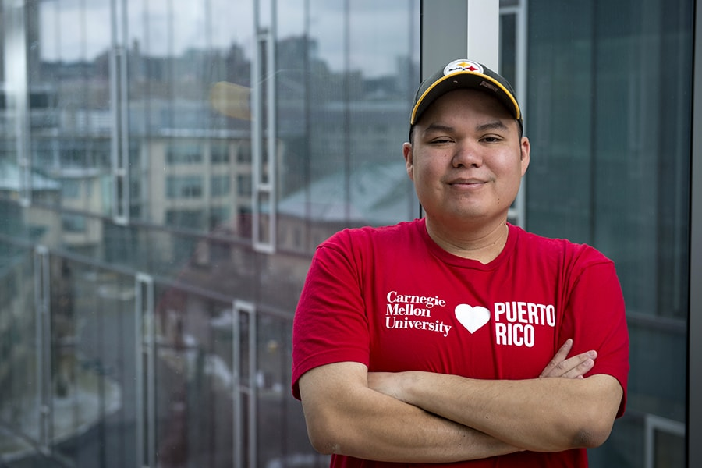
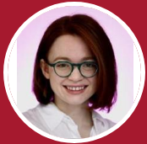
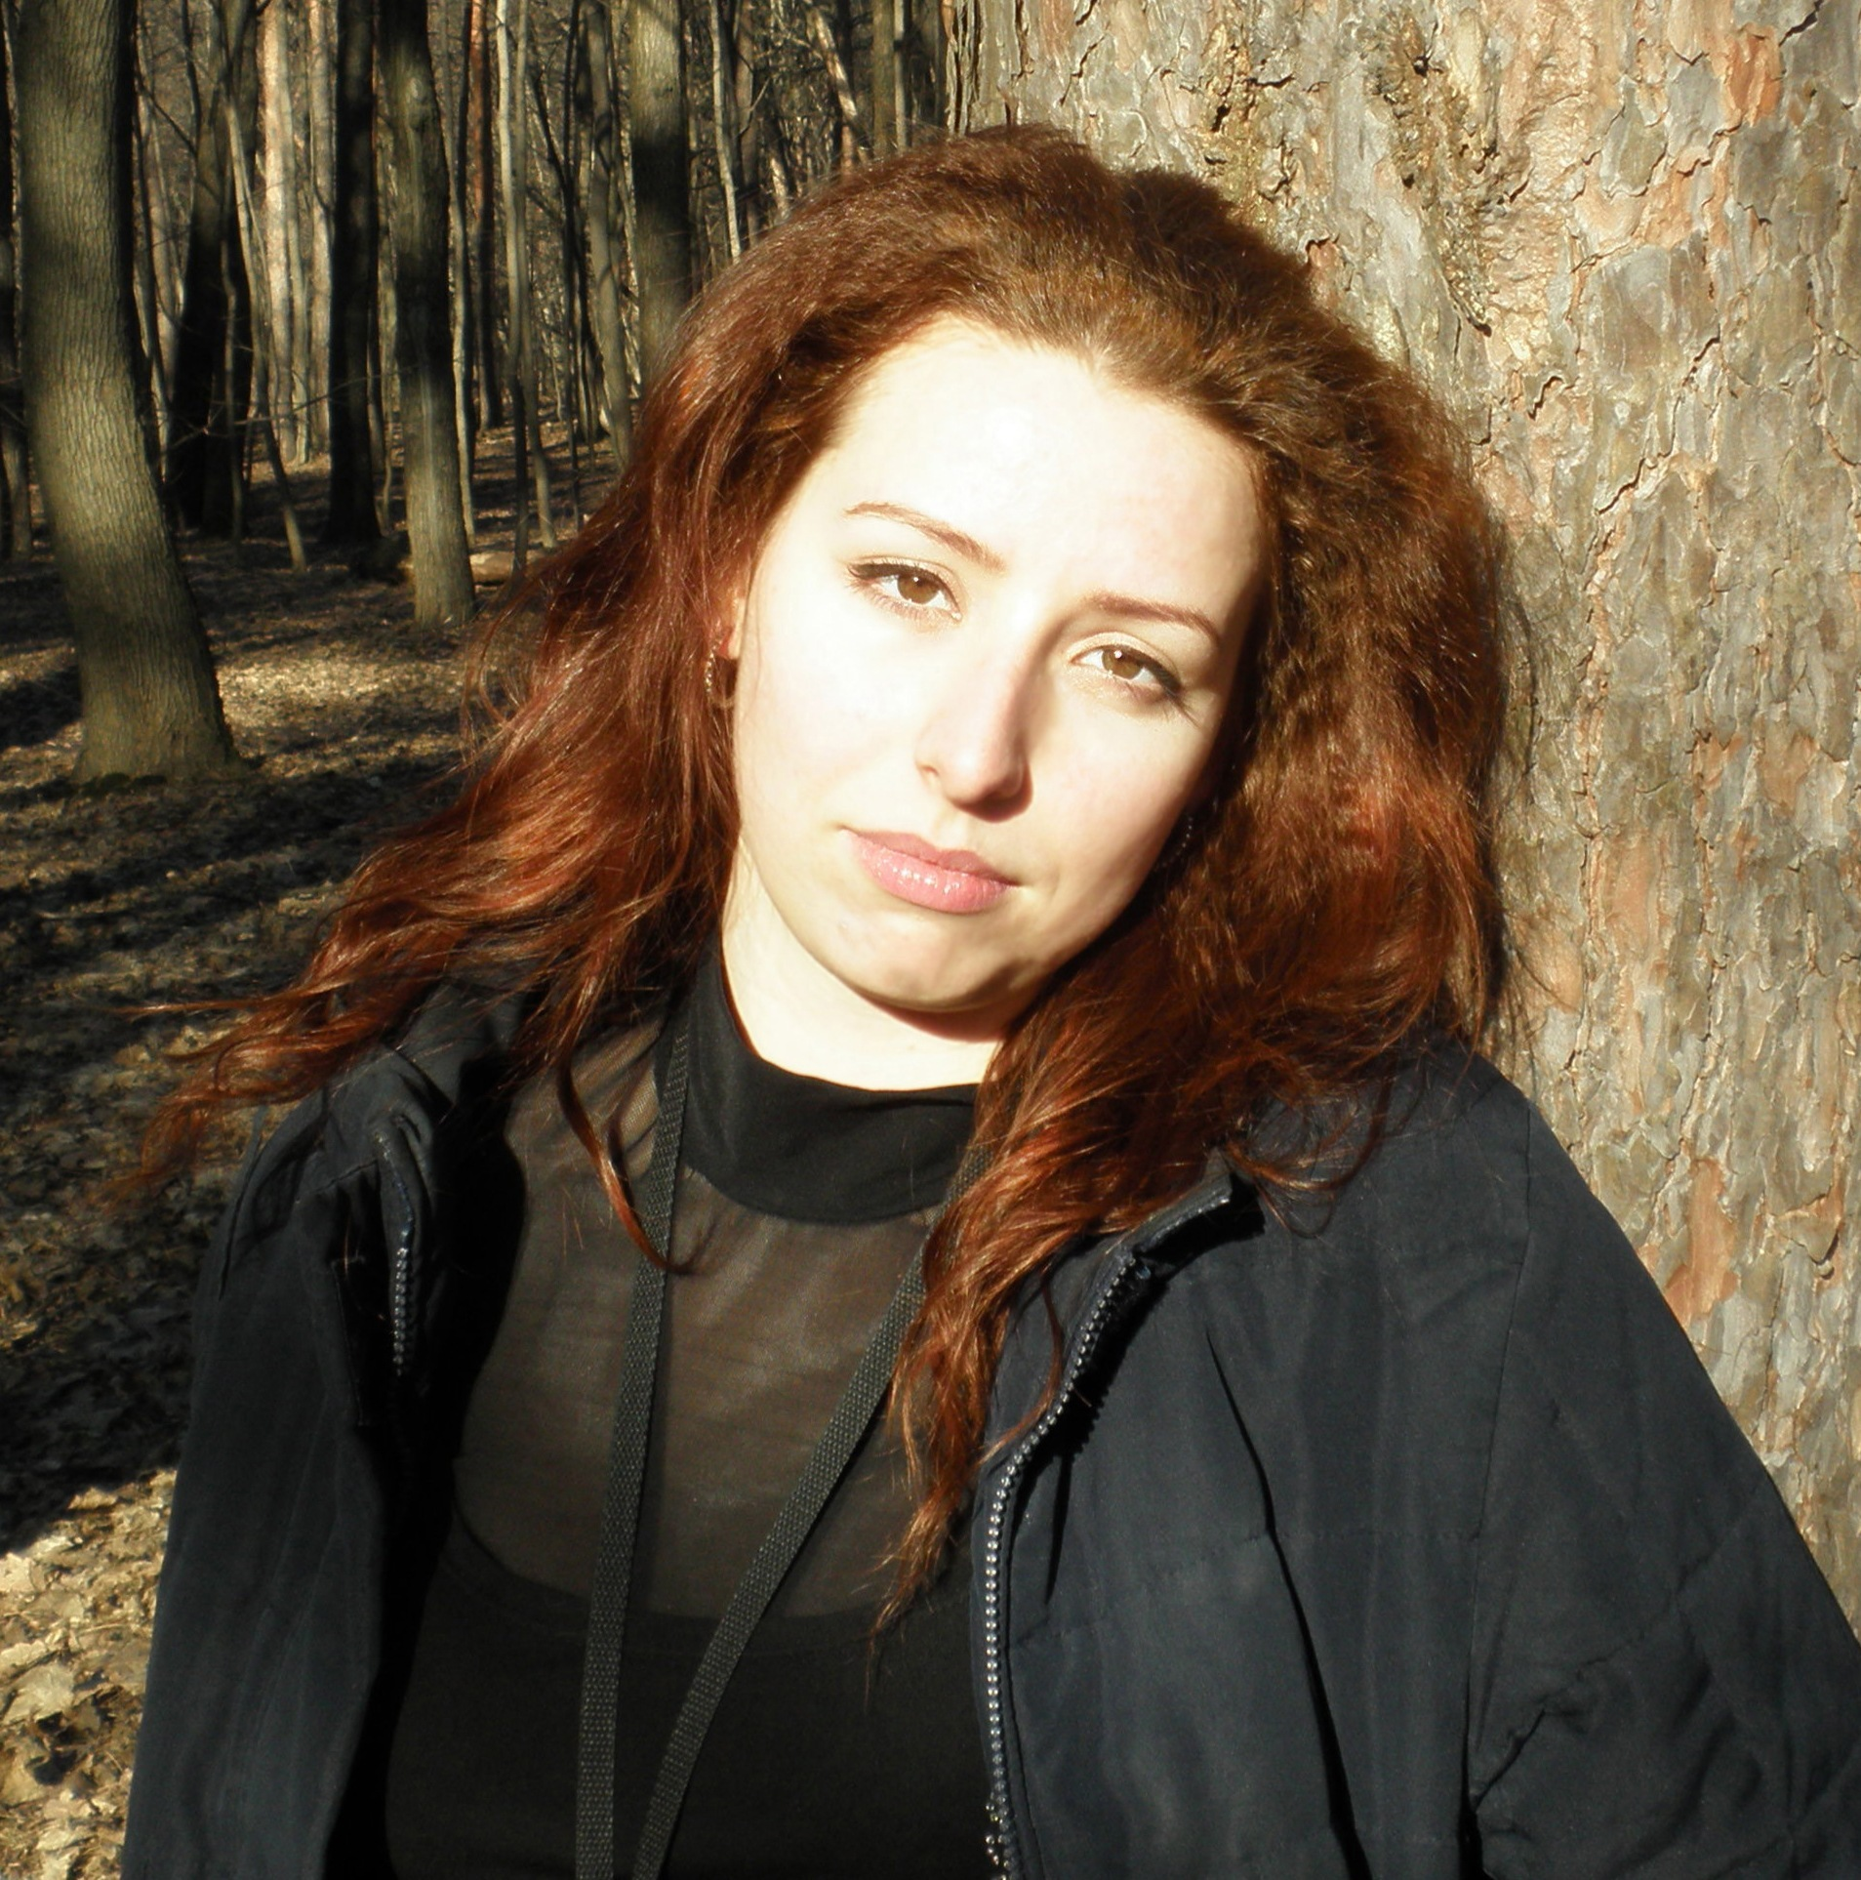
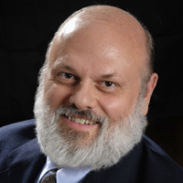
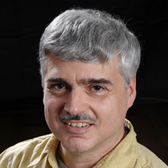
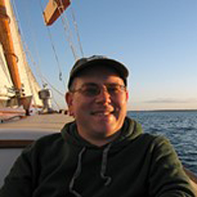
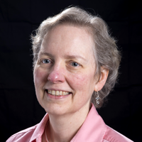
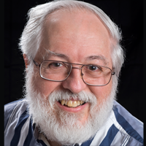

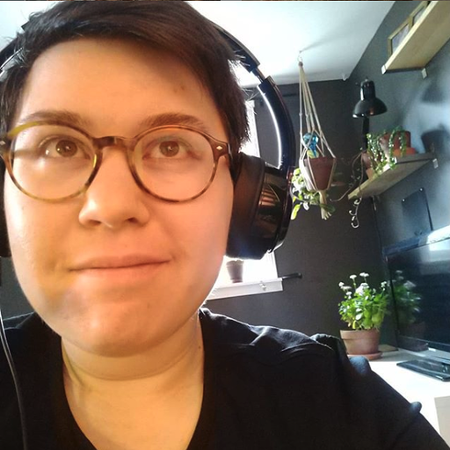
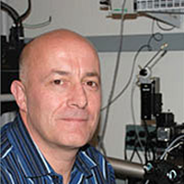
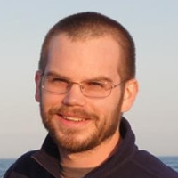

The Brain Image Library: Data Submission Workshop – April 3, 2023
Kathy Benninger (Networking)
Greg Hood (Image Analysis+ HPC)
Derek Simmel (Systems+Security)
Arthur Wetzel (Image Analysis)
Luke Tuite (User Support+Web)
Ivan Cao-Berg (Software+Support)
Elizabeth Pantalone (Web)
Mariah Kenney (Data Curator)
Alan Watson (PI)
Simon Watkins (Microscopy)
Iana Vasylieva (Post-Doc)
Alexander Ropelewski (Contact PI)
Alex
Greg
Derek
Kathy
Art
Luke
Ivan
Liz
Mariah
Simon
Alan
Iana

Slide 2
Workshop Agenda - Today
Topic | Length (mins) | Schedule (EDT)
Introduction & Scope of BIL | 20 | 1:00 - 1:20
Using the BIL Portal Data Transfer Rsync Globus SFTP Using OnDemand for cleanup/organization | 45 | 1:20 - 2:05
File Organization | 15 | 2:05 - 2:20
Break | 15 | 2:20 - 2:35
Metadata File | 30 | 2:35 - 3:05
Uploading Metadata Submitting for Publication | 5 | 3:05 - 3:10
Validation Process & Timeline | 10 | 3:10 - 3:20
Requesting a DOI | 15 | 3:20 - 3:35
Questions/Discussion/Individual Help | 25 | 3:35 – 4:00

Slide 3
Workshop Agenda - Tomorrow
Topic | Length | Schedule
How to find BIL data Website Inventory DOI | 25 | 1:00 - 1:25
Tools Available at BIL | 5 | 1:25 - 1:30
Jupyter Lab/Open OnDemand Neuron Visualization Registration | 30 | 1:30 - 2:00
Break | 15 | 2:00 – 2:15
BIL Analysis Ecosystem and Data Visualization | 1:15 | 2:15 – 3:30
Questions/Discussion/Individual Help | 30 | 3:30 – 4:00

Slide 4
The Brain Image Library: Data Submission Workshop – April 3, 2023
Kathy Benninger (Networking)
Greg Hood (Image Analysis+ HPC)
Derek Simmel (Systems+Security)
Arthur Wetzel (Image Analysis)
Luke Tuite (User Support+Web)
Ivan Cao-Berg (Software+Support)
Elizabeth Pantalone (Web)
Mariah Kenney (Data Curator)
Alan Watson (PI)
Simon Watkins (Microscopy)
Iana Vasylieva (Post-Doc)
Alexander Ropelewski (Contact PI)
Alex
Greg
Derek
Kathy
Art
Luke
Ivan
Liz
Mariah
Simon
Alan
Iana

Slide 5
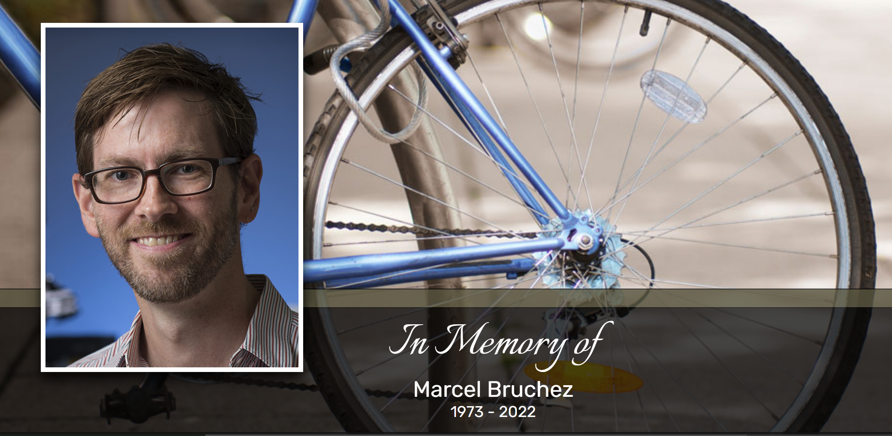

Slide 6
Goals and Agenda
What is the Brain Image Library
Scope, Types of Data and Data Coverage
Additional Services Offered
Coming Attractions
How Do I get Started:
Pre-funding Stage
Funding has Been Awarded
Data Submission

Slide 7
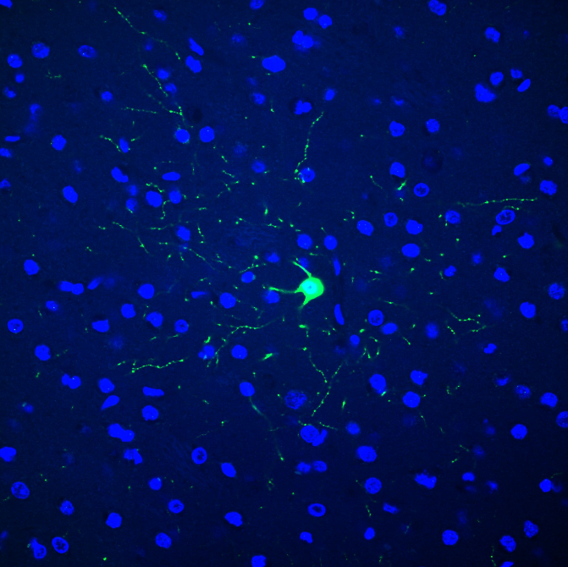
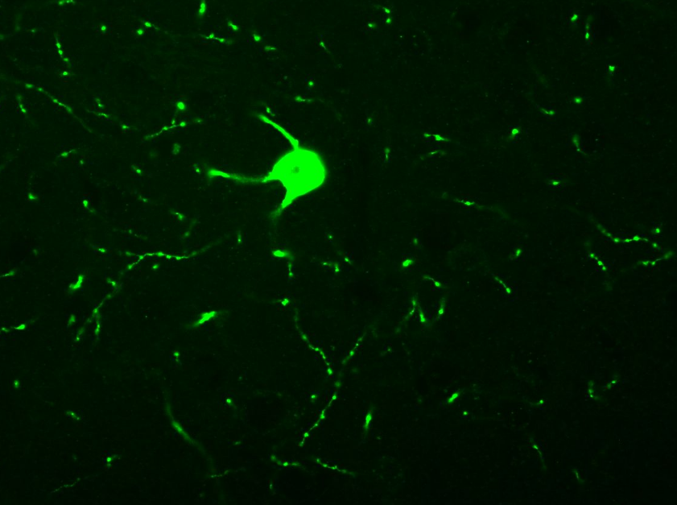
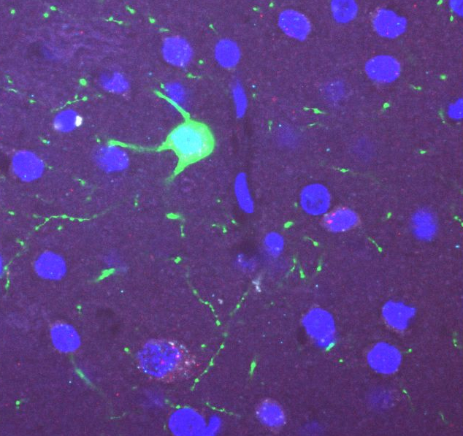
The Brain Image Library
Mission: National public resource enabling researchers to deposit, analyze, mine, share and interact with microscopy datasets of the brain.
Scope:
Permanent repository for high-quality brain microscopy datasets
All NIH Investigators are required to deposit their data and make it publicly accessible.
NIH BRAIN Initiative funded investigators producing microscopy data are required to deposit their data in BIL.
Funding is not required to deposit data in BIL, but data deposited must be of interest to BRAIN Initiative.
Contributing data to BIL is free, there is no charge to contribute data.
Provide Analysis Ecosystem with desktop visualization and HPC computing capability for pre-submission data processing and post-submission exploration at no charge
Provide user access and support including network path analysis
Guping Feng - Spatial Transcriptomics/morphology
/bil/data/3f/1f/3f1f48f95a61068d

Slide 8
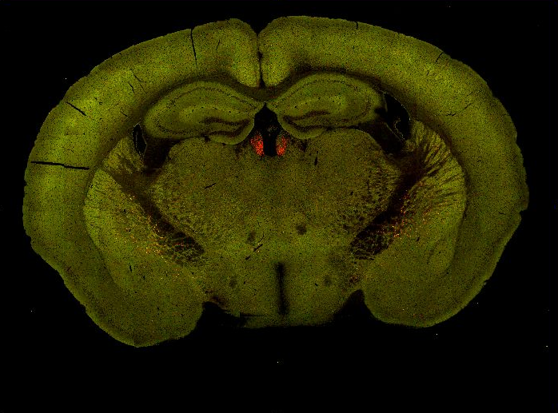
Breadth of Data
Data Scope:
Whole (and partial) brain image datasets of mouse, rat, human, other mammals and model organisms along with their higher-level aligned and tracing data
Targeted experiments including connectivity between cells and spatial transcriptomics ( *FISH)
Historical collections
Pavel Osten – Cell Counting
/bil/data/4d/6c/4d6ccd17bd266fe5/Chat_Ai75_F_334940_171021

Slide 9
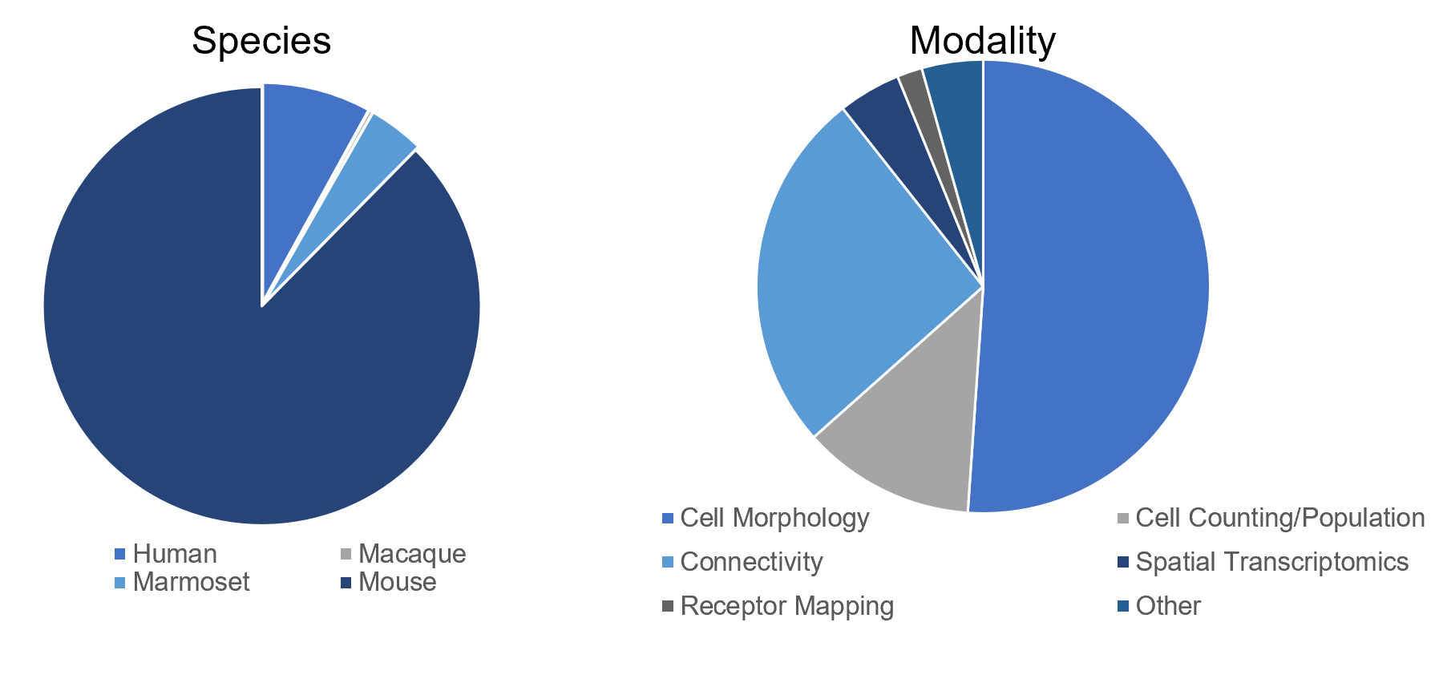
Deposited Data Coverage

Slide 10
Deposited Data Coverage

Slide 11
Additional Services BIL offers to Data Contributors
Networking Support
Identify bottlenecks with data transfer
Recommendations to resolve last-mile issues
Receive data via alternate media
DOIs
Dataset DOIs (enable tracking of data usage)
Group/Collection DOIs
Analysis Ecosystem
Pre Submission Processing
Public Data Exploration

Slide 12
BIL Analysis Ecosystem
BIL Computational, Visualization, and High-Speed Networking Systems to process and explore BIL data in-place available at no charge for open research and to support courses
Analysis Ecosystem
BIL Virtual Machines (Web Serving)
BIL Data Transfer
BIL Virtual Machines
(Remote Desktop)
/bil storage
BIL Tape System
BIL Computational Cluster
Bridges-2 HPC System
Neocortex (Cerebras CS2 System)

Slide 13
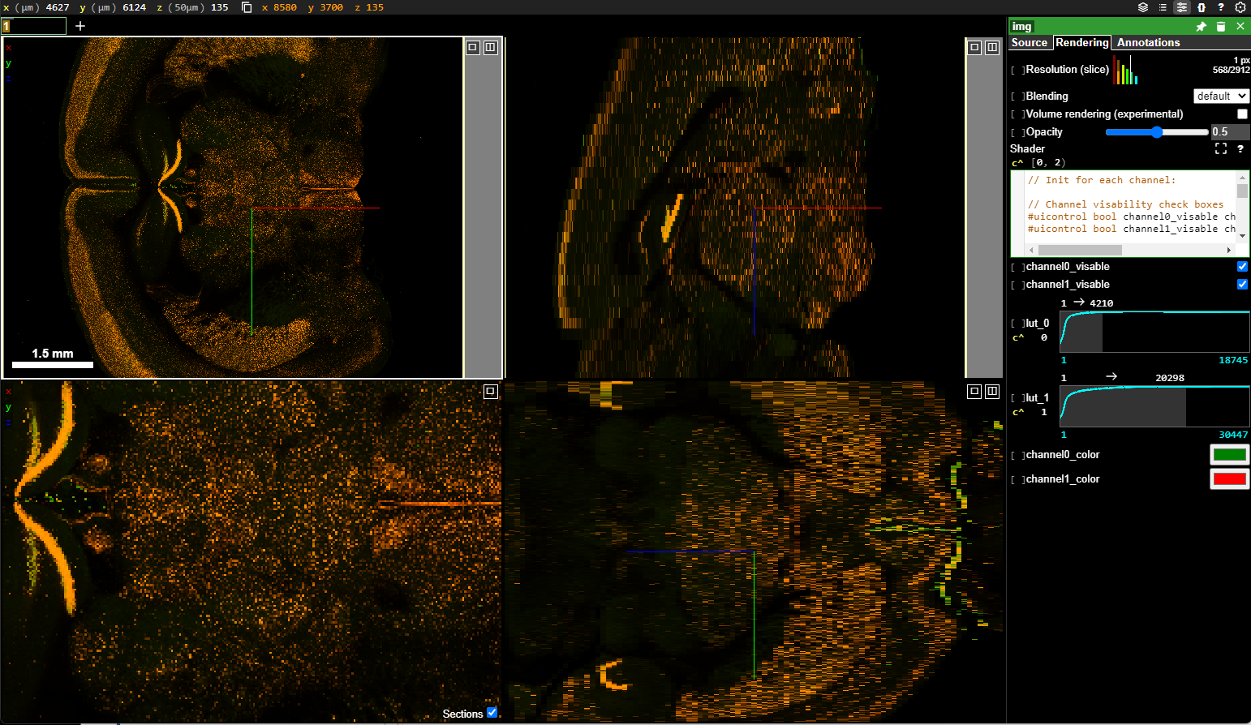
Future: Making Data More Accessible
On-Demand Transformer
Serving data in selected formats
Greater coordination and linkage with large consortia including BICAN
Metadata usability and greater accessibility
Metadata crosswalk
Links to related resources
Manage project space and resources through ACCESS
Originally Submitted Format
2d Formats:
OME-TIFF
JPEG2000
3d/Viz Formats:
Neuroglancer
Napari
Morphology Formats:
SWC
On-demand Transformer
Storage:
Zarr, Hdf, and compatible pyramid formats

Slide 14
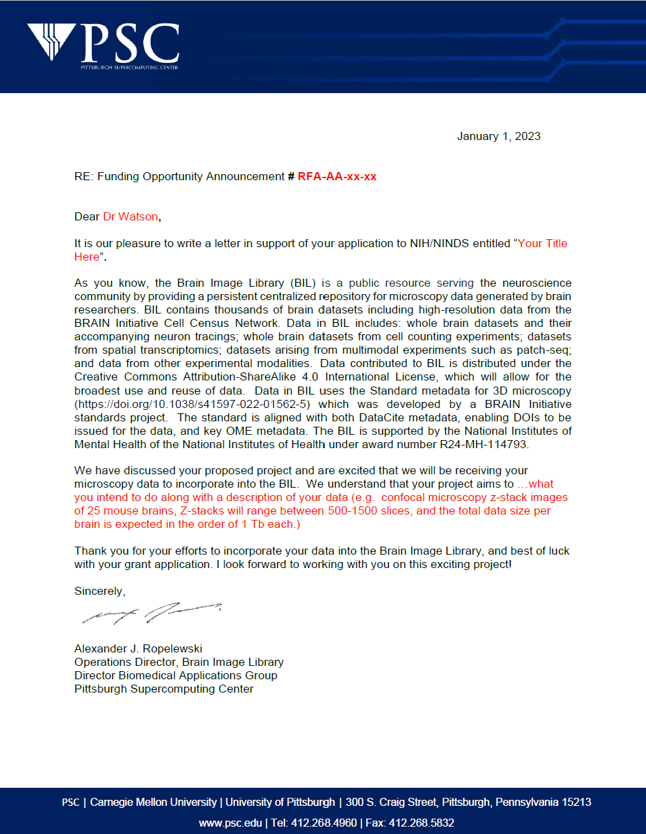
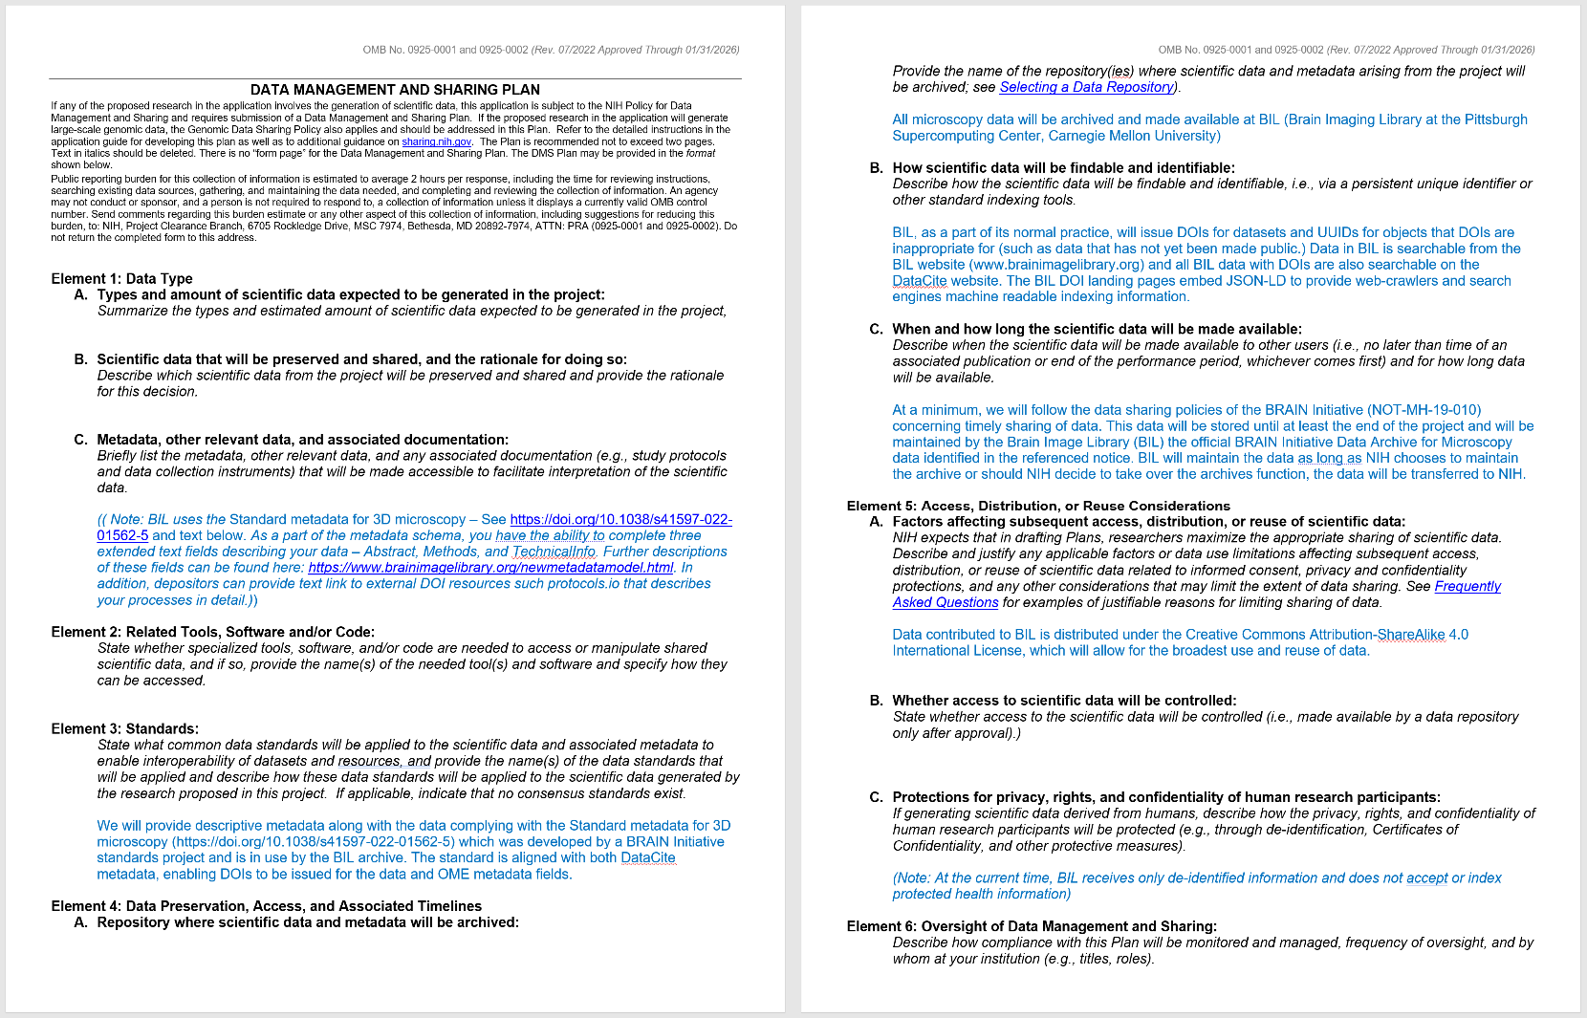
How Do I Get Started?
Pre-Proposal
Beginning of Project
Contact us at bil-support@psc.edu to discuss your project a few weeks prior to submission
We can provide:
A letter of support stating BIL will accept your data
A template (NIH) Data Management and Sharing Plan outlining specific standards in use at BIL.
Contact us at bil-support@psc.edu to discuss your data in detail:
The amount of data to be submitted and the timeframe
The anticipated submission timeline
Visualization
We will advise you on:
The current metadata template most appropriate for your data.
How to structure your data to endure that it can be visualized
How to gain access to the BIL systems, including the Analysis Ecosystem
Upcoming training

Slide 15
Plan Ahead for Data Submission
Start the data submission process well-in-advance of any deadlines that you may have for making the data public
Consider the time required to move data:
We can provide assistance locating where the transfer bottleneck is occurring
Data validation time will be proportional to the number of files in the submission:
Smaller number of large files validate quicker
Smaller total number of datasets in submission will validate quicker
Curation team may need your assistance to resolve issues

